Slide 1


Jenkins Pipeline as Code at 30,000 Feet
(non-technical)
Eric Starr
DevOps Engineering Tech Leader
Eric.Starr@Optum.com

Slide 2

Eric Starr
21 Years in IT
12 Years in various roles and some at the same time
Java Web Application Developer/Tech Lead
9 Years in CI/CD -> DevOps
5 Years at Optum: DevOps Engineering – Building Solutions
Today
Building DevOps Technical Solutions for the Enterprise
Leading Innersource Team of Jenkins SMEs to build out a Jenkins Pipeline as Code Global Pipeline Library
Blog: http://automateagility.com
GitHub Org: http://github.com/starrman777
LinkedIn: https://www.linkedin.com/in/starrman/

Slide 3
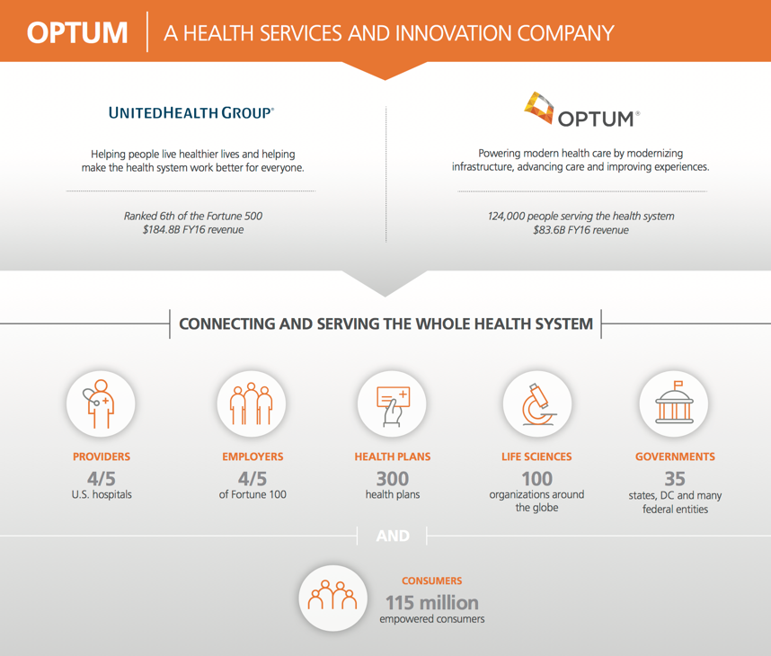
Optum – A Health Services and Innovation Company

Slide 4
Agenda for 1st Presentation
1
What Problem Are We Trying to Solve
2
What is Jenkins
3
What is a Jenkins Pipeline
4
Jenkins UI – Dashboard and Job Config
5
Jenkins Pipeline as Code
6
Global Pipeline Library

Slide 5
Agenda for 2nd Presentation
2nd Presentation
DEMO
Where to Get More Help
Q&A

Slide 6
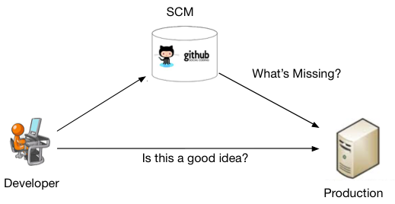
What Problem Are We Trying to Solve
SCM Commit Production
Fat fingered updates
Forgetting configuration changes
Production server is pointed to the Dev DB
Several day deployments
Service down for several days

Slide 7
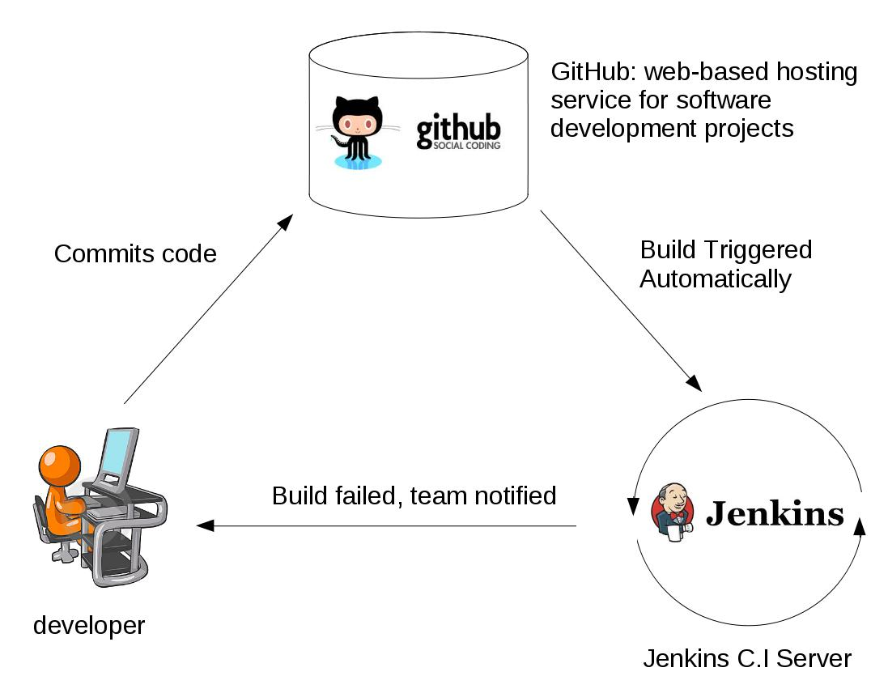
What is Jenkins
Commit Trigger Build Feedback
With Jenkins
Centralized build server
Broken Builds are now exposed to everyone
Notes:
Is It Possible to Screw This Up?

Slide 8
October 01, 2013
Why is this date important in the
history of software development?

Slide 9

HealthCare.gov

Slide 10

HealthCare.gov – October 01, 2013
Notes:
How Do you Fix This Problem?

Slide 11

Can You Throw Money at the Problem?
Nov 06, 2013
Notes:
The Government Can

Slide 12


Day 0 - Coming to Save America’s Healthcare
Notes:
What do you think we found when we got there?

Slide 13

Day 1 & 2 We Couldn’t believe What We Saw
Notes:
Here is one of our Senior Architects after about 3 days

Slide 14

Day 3 and Beyond Our Frustrations Grew

Slide 15
Finally – Victory – Nov 30, 2013

Slide 16
HealthCare.gov
What did they do right?

Slide 17

HealthCare.gov – What did they do right?
Notes:
Is Jenkins a Magic Bullet?

Slide 18
HealthCare.gov – What Did They do Wrong?
Story Time
“They Get in the Way”
Notes:
Is this really a Technical Problem or a Cultural Problem?

Slide 19
The Real Presentation Begins Here
Jenkins will only do what you tell it to do.
When you have poor quality standards you have disastrous, very public, lifelong embarrassing failures.
Automating a bad process enables you to deliver poor quality very fast.
Using Jenkins we can automate a well defined build/test and deployment pipeline.

Slide 20
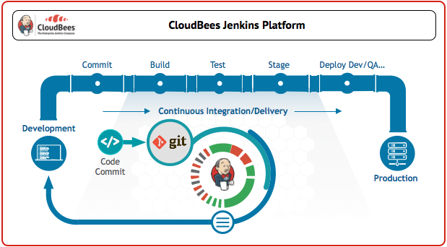
What is a Jenkins Pipeline
Jenkins Pipeline

Slide 21
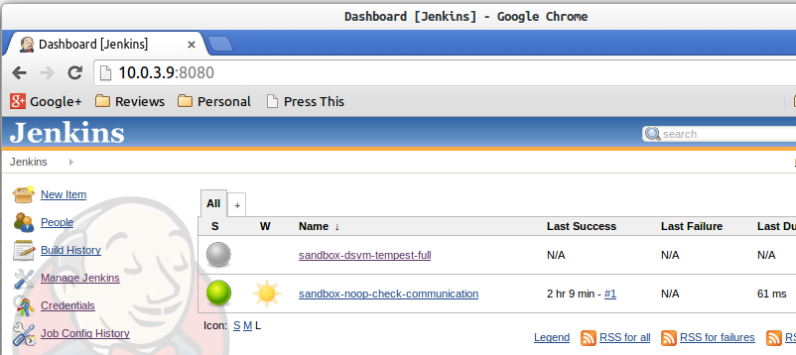
Jenkins UI and Job Config
Dashboard

Slide 22
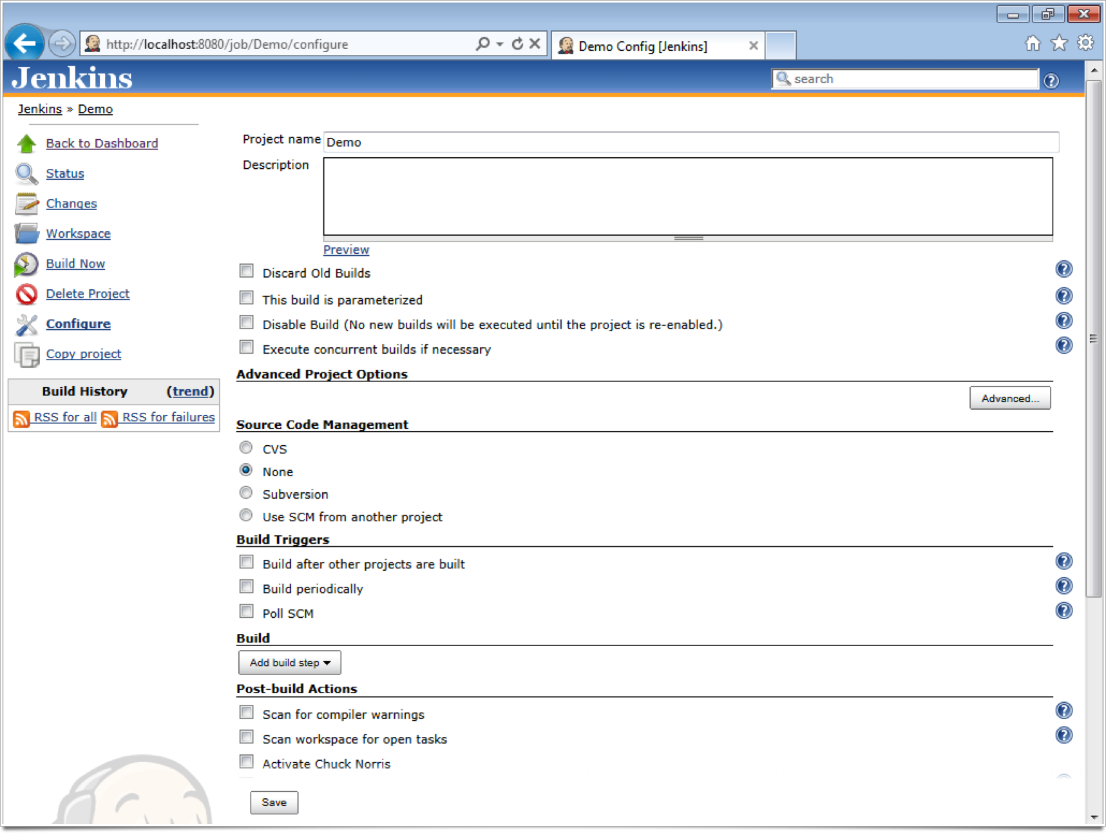
Jenkins UI and Job Config
SCM
Build Triggers
Build
Post Build Actions

Slide 23
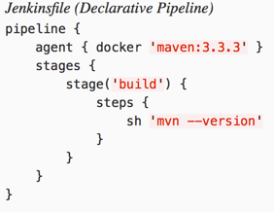
Jenkins Pipeline as Code
SCM
Build Triggers
Build
Post Build Actions
Jenkins Pipeline as Code Benefits
Features Delivered faster
Checked into source control
Versioned
Easily Sharable within an Organization
Notes:
350 lines

Slide 24
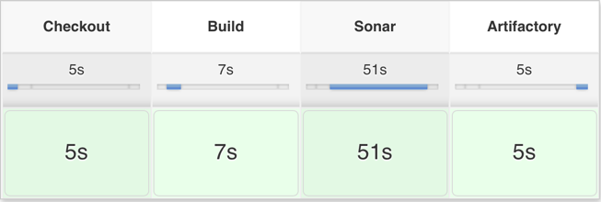
Jenkins Pipeline Stages

Slide 25

Global Pipeline Library
Global Pipeline Library Benefits
Faster Software Production
Greater Revenue Gains
Better Response to Market Conditions
Exponential Time and Money Savings
Increases Reusability – DRY
Easy to Add Quality Across Enterprise
Lowers Technical Barriers to Get Started
Encourages Inner-sourcing

Slide 26
What Can We Automate?
Build
Sonar Scan
Code Coverage
Unit Tests
Artifact Deployment
Performance Tests
Fortify Scan
Docker Image Build, Tag, Push
Deployments to Dev, QA, Prod
Notifications
OpenShift Promotions
Everything Automatable…

Slide 27
Aligning Dev, QA, OPS, Security, etc…
DevOps Is This All DevOps Is?
Aligning around the Jenkins Pipeline Helps everyone go in the same direction.
NO – Just a Piece of the Puzzle.
Notes:
Starting Down the Path Toward DevOps

Slide 28
Where to Get More Help
Jenkins Sites:
https://jenkins.io
https://jenkins.io/solutions/pipeline/
https://jenkins.io/doc/pipeline/examples/
Community Blog Sites
http://automateagility.com (Eric Starr’s Personal Blog Site)

Slide 29
Questions
& Answers

Slide 30


